Slide 1
Gender-Based Differences in Job Descriptions
Team 5 – Liron Cohen, Yuval Mor, Ofer Tlusty

Slide 2
Research problem
Gender-based differences in job descriptions in the software engineering industry
Women may be discouraged from applying for jobs in male-dominated
We aim to examine job descriptions and explore the impact of job characteristics on women's job application decisions.

Slide 3



About us
We are all connected to the gender-biased problem in the high-tech industry.
We strive for gender-equality and we want to help the recruitment teams to be as much inclusive as possible when they are writing job descriptions.
We also used labor studies team as domain experts.
Notes:
We decided to research this topic as we are all connected to the gender-biased problem in the high-tech industry. We want to help the effort of gender-equality and help the recruitment teams to encourage women to apply and be as much inclusive as possible when they are writing job descriptions.
We used labor studies team as domain experts.

Slide 4
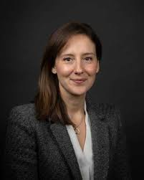


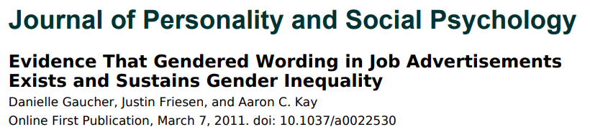




Literature review
We were mostly influenced by 2 articles:

Slide 5
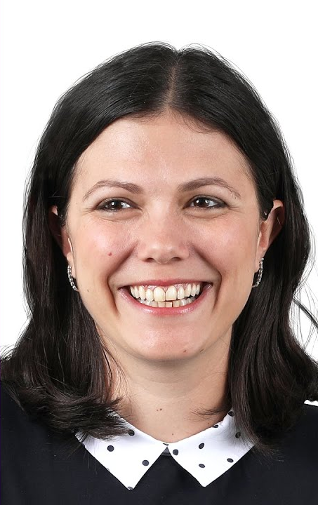
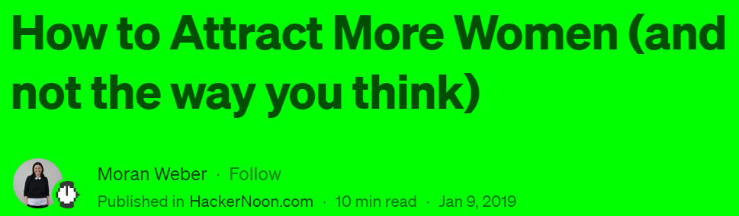
Literature review
We were mostly influenced by 2 articles:

Slide 6
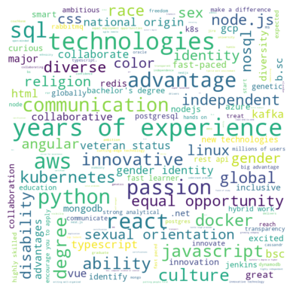
LinkedIn job description analysis
Analyzed our LinkedIn job description database – extracted phrases that can discourage women from applying to the job
Looked for phrases from our experts (labor studies team) and used an NLP model to enrich the list
Analyzed statistically the phrases per category (work environment, skills etc)
results per description and per phrase:

Slide 7
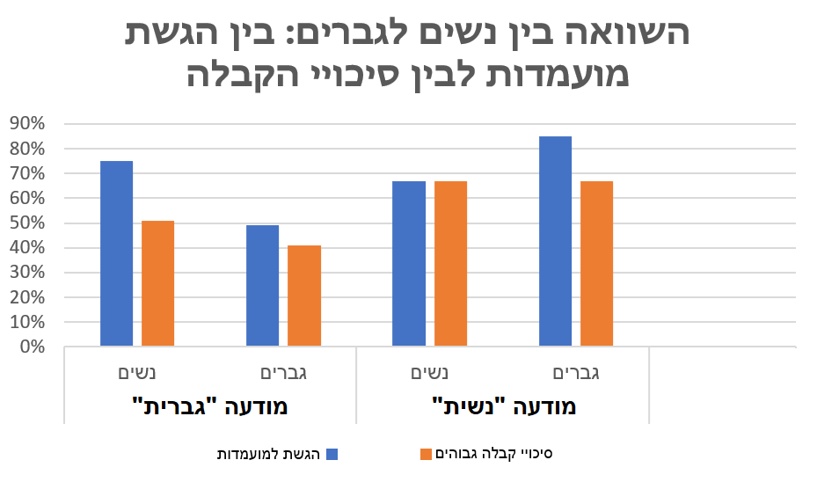
Labor studies survey results
We conducted a survey in collaboration with labor studies team with interesting results
Notes:
מיטל: הסבר לפער 1. שינוי מגמה (בסקירה הספרותית המחקרים מלפני 10 שנים, ראינו שרב העונות לסקר היו בטווח של 6-8 שנים ניסיון מה שמעיד על דור הZ/Y
2 החסרנו כטנולוגיות מראש לטובת גנריות של תיאורי המשרה וראינו שרב הגברים אמרו שלא הגישו בגלל חוסר בטכנולוגיות לעומת נשים שחלקן הגישו דווקא בגלל : חוסר דרישות טכנולוגי

Slide 8
Our last iteration goal
The last iteration’s goal was to build and train an ML model to grade job descriptions on how gender-inclusive (or gender-biased) it is

Slide 9

Challenges and solutions
We don’t have labeled data
We wanted to use a survey for labeled data – not enough
Labeling with an LLM
Building an ideal prompt
Didn’t agree to give us what we needed
Manual labeling
We don’t have data of a very gender-biased job descriptions
LLM doesn’t label whole job descriptions very well
Changed to sentences
Training a model on an unbalanced data

Slide 11
Our final prompt for labeling
Rank the gender bias of the following job description on a scale of 1 to 3, where:
1: Gender-Neutral - inclusive language and avoids any bias towards a specific gender. It treats all applicants equally.
2: Mild Gender Bias - may contain subtle biases or stereotypes that could potentially deter or discourage applicants of a particular gender.
3: Severe Gender Bias - displays explicit and significant bias towards a particular gender, potentially limiting opportunities for candidates of the opposite gender. The language, requirements, or expectations may perpetuate stereotypes and reinforce unequal treatment.
Please evaluate the job description based on its language, preferred qualifications, and any implicit assumptions made about gender roles. Consider how the description may influence the perception of applicants and their willingness to apply.

Slide 12
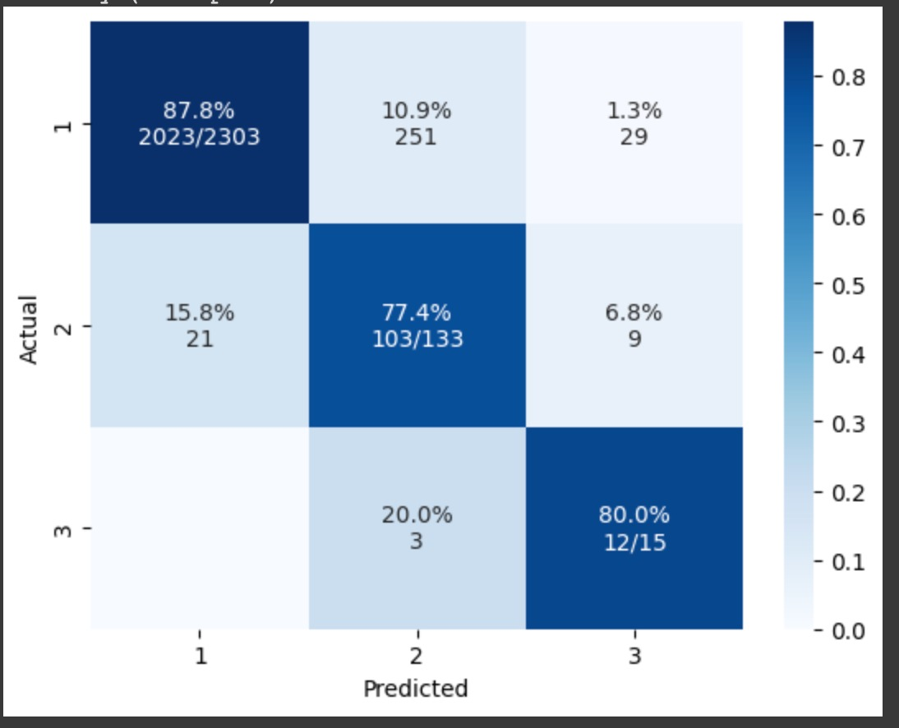
Results
We built ML model that given a sentence, grades it on a gender- biased scale based on examples we gave it in the training phase.
Model accuracy on a 80-20 test set is 0.87!

Slide 13
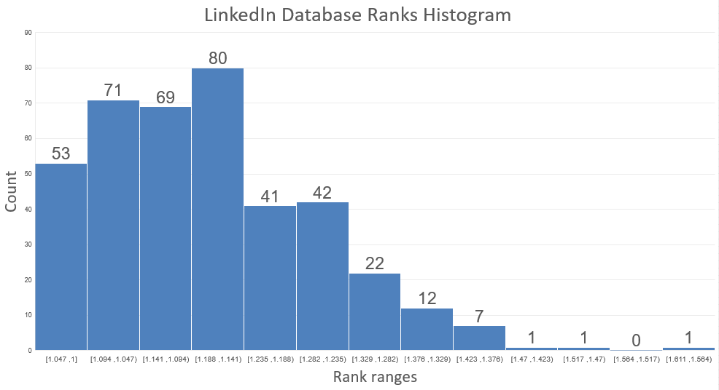
Results
Our main program gets a job description, split it into main sentences, send them to our model and calculates a final grade to the job description.
Results for our LinkedIn database

Slide 14
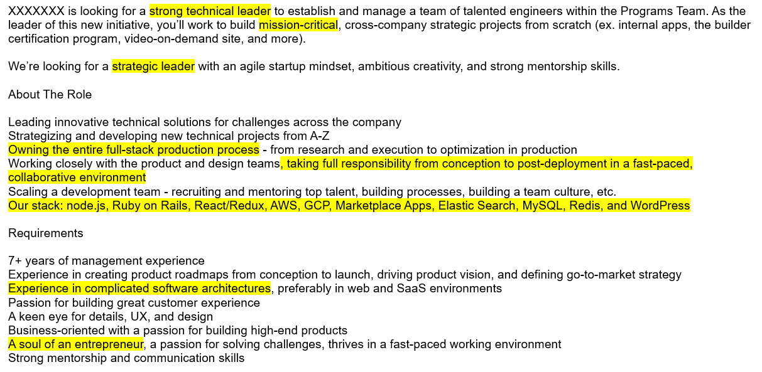
Gender-biased example – ranked 1.57/3

Slide 15
Ethical Considerations
Couldn’t get data from companies due to privacy protection
Biases in labelling and sentence generation
Ethical use of findings

Slide 16

Project accomplishments
A program that gets a job description and grades it based on how gender-biased it is.
A bank of phrases and words that can discourage women from applying to job descriptions.
Knowledge on the recruitment and HR domain.
Knowledge on research process, troubleshooting and challenges overcoming.

Slide 17

Thank you!

